Slide 1
Tile : Revolutionize Population PK Analysis with CDISC Standards Speakers Neelima Thanneer (BMS), Fang Li (FDA), Luke Reinbolt (Navitas)

Slide 2
Disclaimer
The opinions expressed in this presentation are the presenter’s and do not necessarily reflect ISoP and/or CDISC

Slide 3
Why Standards for popPK Datasets?
Improves Efficiency and Quality
Minimizes Variability
Streamlines Collaboration
Clear Implementation Guidelines
Enables Automation
Expedite Regulatory Review

Slide 4
Journey of ADPPK
2023
Published ADaM ADPPK IG under CDISC
2020-2023
Published Version 1 of popPK Data Standards under ISoP @ACoP
Established ADaM ADPPK Working Group in December 2020
Approximately 20 people including CDISC experts, programmers, pharmacometricians and ISoP Working group members
Made ISoP standard compliant with CDISC ADaM
2015-2020
Established The Data Standards Working Group under ISoP
Approximately 30 scientists and programmers
Developed standard for population pk analysis datasets

Slide 5
What is CDISC? What is ADaM?
Clinical Data Interchange Standards Consortium (CDISC)
Quality standards
Greater efficiencies
Focus on breakthroughs
Analysis Data Model (ADaM)
Specifies the fundamental principles and standards to ensure clear lineage from data collection to analysis
ADaM is one of the required standards for data submission to FDA (U.S.) and PMDA (Japan).

Slide 6
ADaM datasets and metadata
Traceability
Readily usable with commonly available software tools
Analysis ready
Must clearly and unambiguously communicate the content

Slide 7
ADaM Classes/Subclasses
ADSL
BDS
ADNCA
ADPPK
OCCDS
ADaM Other

Slide 8
ADaM BDS
Vertical design
Contains one or more record per subject per analysis parameter per analysis timepoint
Allows the copying of variables directly from the source data
Provide robust and flexible support for the performance and review of most statistical analyses.
A record in an ADaM dataset can represent an observed, derived, or imputed value required for analysis.
Is flexible in that additional rows and columns can be added
support the analyses
provide traceability

Slide 9
ADaM BDS Subclasses
Why use Subclasses
Leverage stability/traceability
Follow the general structure
Allow for minimal changes
Conformance checks
Allows for standard industry conformance checks to be easily run
Can utilize checks already in place
Easily adaptable for companies’ submission process
ADPPK follows BDS in a similar way to ADNCA

Slide 10
CDISC Review Process
Review by :
ADaM
Internal CDISC-GGG
CDISC Public - GGG
FDA
Addressed comments at each stage
Link for the published CDISC ADaM ADPPK Implementation Guide
https://sxpsig.github.io/files/BDS%20for%20ADaM%20PopPK%20Implementation%20Guide_v1.0_0.pdf

Slide 11
Implementation of ADPPK
Recommended datasets name suffix is ADPPK, e.g., ADPPKxyz
Included popPK specific variables like DV, EVID, CMT etc
Adopted ADaM naming conventions
Time variables
Uses suffix -RLT to represent relative time
Using the suffix -TM will cause errors with common conformance rule checks
Added variables like PARAM, PARAMCD, AVAL to be complaint with ADaM
PARAMCD values can be
"DOSE" for EVID=1,
"PK" for EVID=0. If its PD we can add accordingly
PARAM values can be TRTGRP values for EVID=1 and carryforward from PC for EVID=0
AVAL=DV
Included variables for identifying exclusion and imputation records.
FLGREAS Captures primary reason for identifying the record for data issues (e.g., dose time imputation flags).
A sequential number starting with 1 and increments with each unique reason
FLGREASC Character version of FLGREAS.
EXCLF Record identified for Exclusion from analysis (e.g., day 1 pre-dose sample, BLQ, data issues) Num
EXCLFCOM Comment for the Record Exclusion Char
Provided a list of standard flags in the IG
Notes:
Source data usage principles
Variables from existing domains are not defined again

Slide 12
Implementation of ADPPK
Defined source data usage principles, SDTM vs ADaM
Variables from existing domains are not defined again
e.g., PARAM, PARAMCD, TRTP, TRTA, AVISIT
Included datetime variable for traceability - UDTC
Defined naming conventions for covariates
Defined whether numeric version of the variable is primary or character version
e.g., RACE , RACEN
Units for variables will be added in labels except for variables like AVALU
Recommend extending same variable naming conventions to PKPD or Exposure-Response datasets for the variables defined in ADPPK

Slide 13
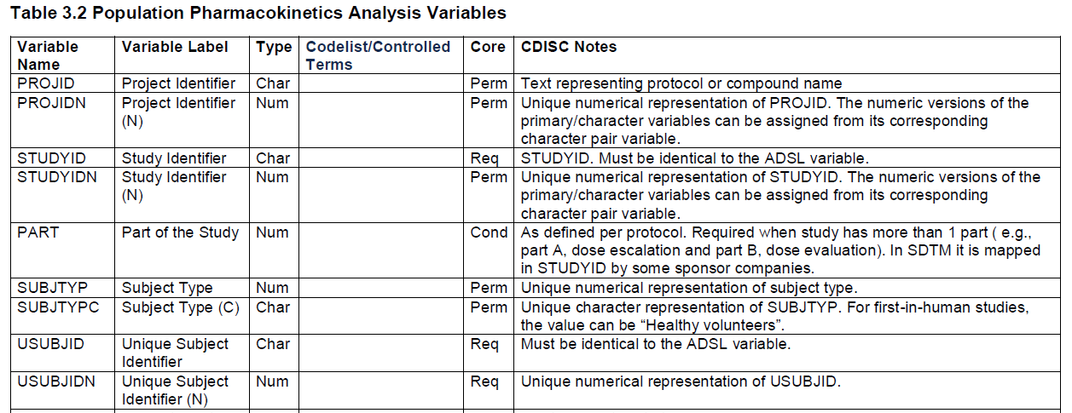
Implementation of ADPPK
Defined core value for each variable
Required or Permissible or Conditional

Slide 14
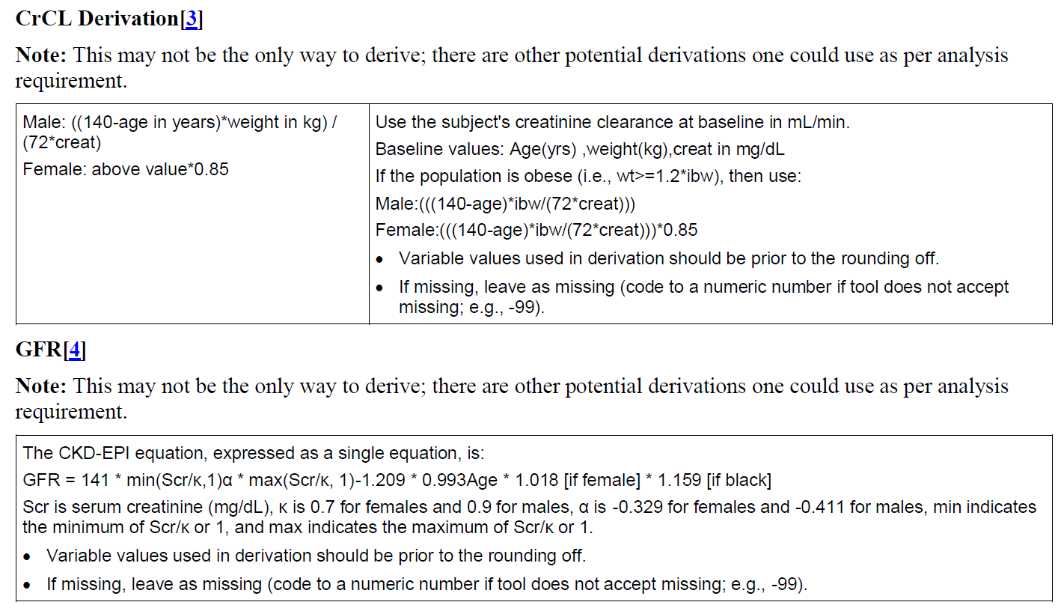
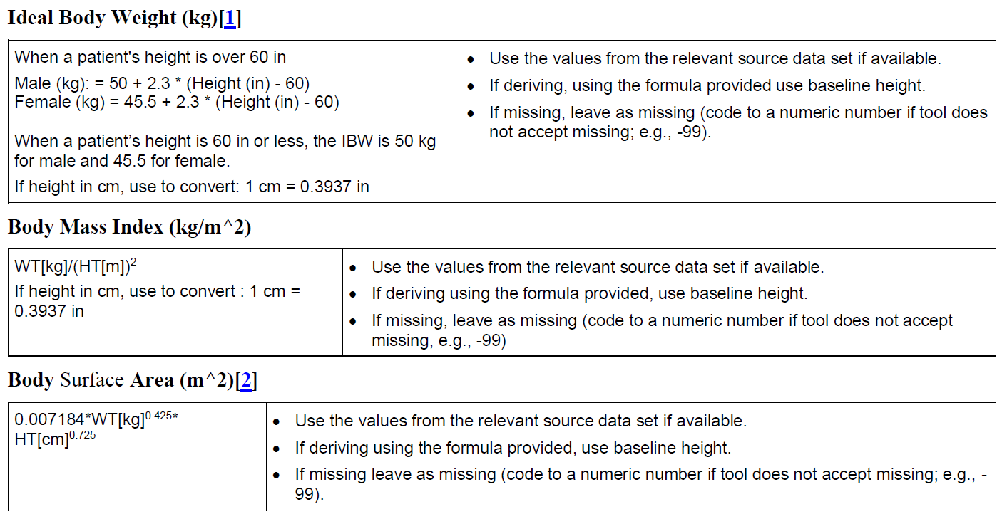
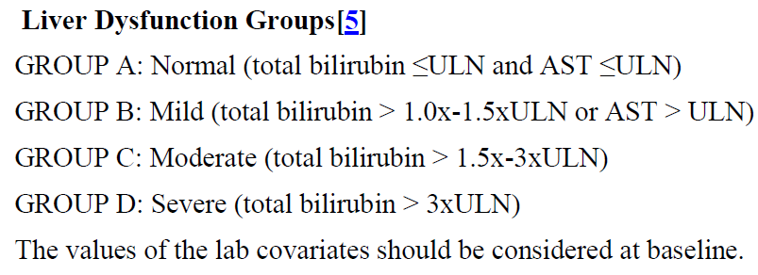
Derivations for Some Typical Covariates
Formulas were provided to calculate some typical covariate values: body mass, renal and hepatic function

Slide 15
Handing of Missing Data
Specific guides were provided for the handling of missing data or data imputation, including:
Missing date and time records
Missing Dose Amount
Missing PK sample date and time
Missing start or stop dose dates and times
Infusion Duration
Infusion rate
All imputed records should be flagged!

Slide 16
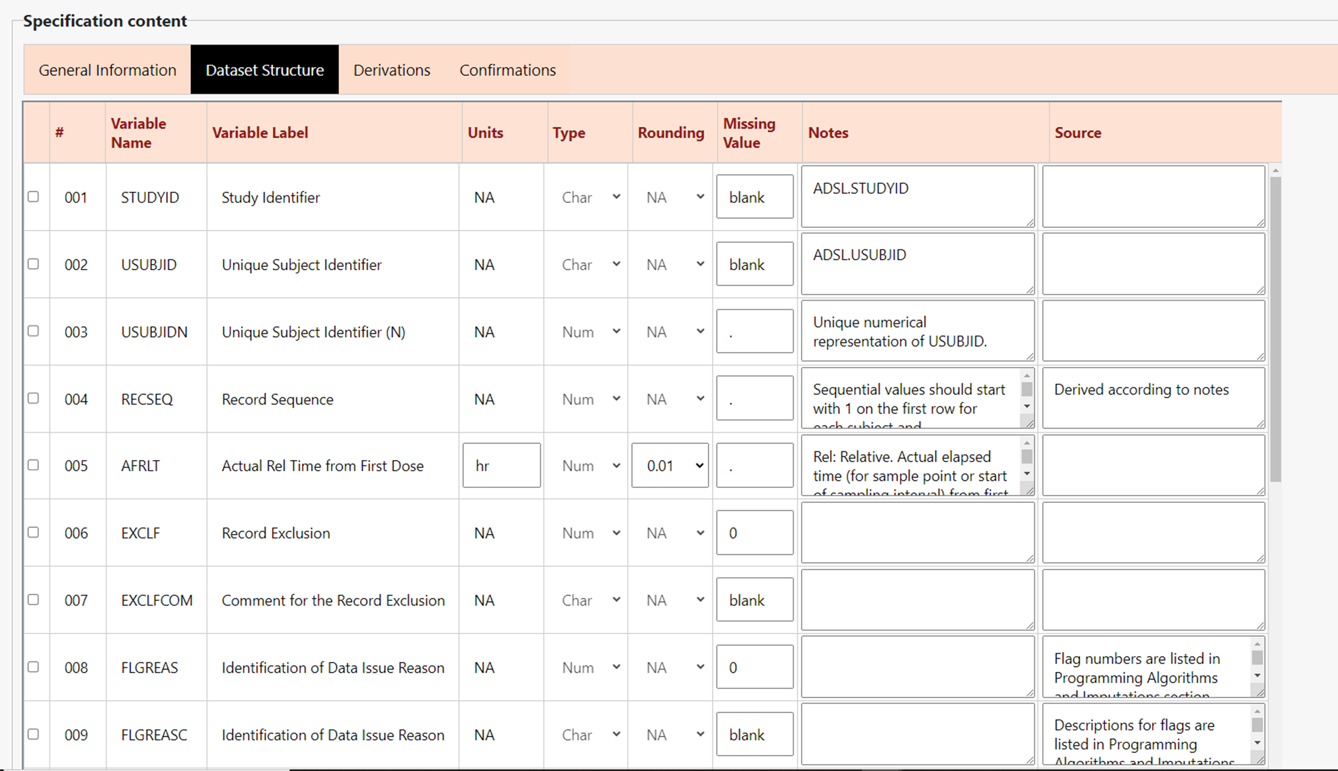
Transition to ADaM ADPPK
All new studies/projects could use CDISC ADPPK Standard.
All ongoing/old projects could phase out at the next update by mapping to new standards
BMS released an opensource webapp that automates the CDISC ADPPK spec creation
https://github.com/BMS-CPP/PMWebSpec
Benefits:
Enforces Standards
Pre-populates variable attributes, derivations and imputation rules
Improves Quality
Improves Efficiency
Ability to search and import specs
External collaboration

Slide 17
Acknowledgements
ISoP Working Group
CDISC Working Group
Name | Organization
Neelima Thanneer, Team Lead | Bristol-Myers Squibb
Luke Reinbolt, Team Lead | Navitas Data Sciences
Paula Edwards-Holmes | Ono Pharma
Nate Freimark | The Griesser Group
Rebecca Humphrey, Susan Sardella | Simulations Plus, Cognigen Division
Hongxia Jia | Karyopharm
Steve Kirby | Reata Pharmaceuticals, Inc
Eric Larson | IQVIA
Pravat Pradhan | MerckGroup
Jessica Purkis | Amgen
David Radke | Eli Lily
Andijana Radivojevic | -
Kumar Rajwani | GSK
Igor Rubets | Certara
Peter Schaefer | VCA-Plus
Shweta Vadhavkar | Genentec
Lacey wood | Avance Clinical

Slide 18
Submitting Population PK Datasets for Evaluation: Regulatory Perspective
Frank Fang Li, PhD
Senior Pharmacometrics Reviewer
Division of Pharmacometrics
Office of Clinical Pharmacology
Office of Translational Sciences
U.S. Food and Drug Administration

Slide 19
Disclaimer
The opinions expressed in this presentation are the presenter’s and do not necessarily reflect the official views of the United States Food and Drug Administration (FDA).

Slide 20
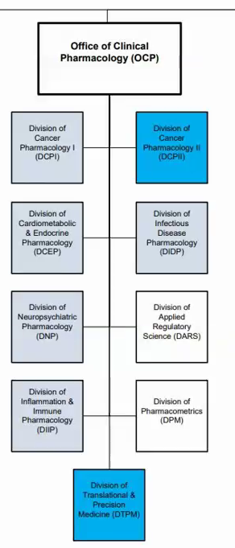
Pharmacometrics at FDA
Structure: Growth
Tasks: Impact
Tools: Efficiency
Largest review division in the office of clinical pharmacology; About 31 review scientists in 2023
A total of seven teams: five review teams covering different therapeutic areas; one dedicated PBPK team and one TQT team
Review staff for QSP models and Artificial Intelligence (AI) submissions
Still growing fast due to increasing need
Population PK/PD Modeling
Exposure-Response Analysis for efficacy and safety
Review tools and templates
Disease database and library
eSafety
Efficacy
Safety
Dosage
Change
Pediatric study
Dose selection, confirmation and optimization
Benefits
/Risks
DDI
505b(2)
Labeling

Slide 21
Model-Informed Drug Development at Office of Clinical Pharmacology
2020 - Beyond
Population PK and E-R analysis are more widely used in:
Dose selection in early Phase studies, such as for R2PD
Dose adjustment and optimization based on clinically significant covariates identified (body weight, age, gender, race, hepatic and renal impairment, etc)
Dose extrapolation in pediatric patients.
MIDD pilot program becomes official
More QSP models submitted to support dosage
Artificial Intelligence (AI) submissions
2010 – Now
Approaching Mainstream
Routine application of pharmacometrics, and PBPK for DDIs
Early applications of semi-mechanistic and mechanistic modeling in review
Opportunistic standardization
Regulatory acceptance of DDT
Organizational growth, assimilation and prioritization
PDUFA VI - MIDD
Emerging areas – Quantitative Systems Pharmacology, Artificial Intelligence/Machine Learning
2000 – 2010
Rapid Growth
POPPK, D/R, E/R,
Guidance,
CTS and disease models,
Early days of PBPK research and application
Division of Pharmacometrics (DPM)
1990 – 2000
Early Days
IVIVC, PK/PD,
POPPK
Pharmacometrics Group
IVIVC – In vitro-In vivo Correlation;
CTS – Clinical Trial Simulation; DDT – Drug Development Tool;
Adapted from Zineh & Woodcock, CPT 2013; PMID: 23571772

Slide 22
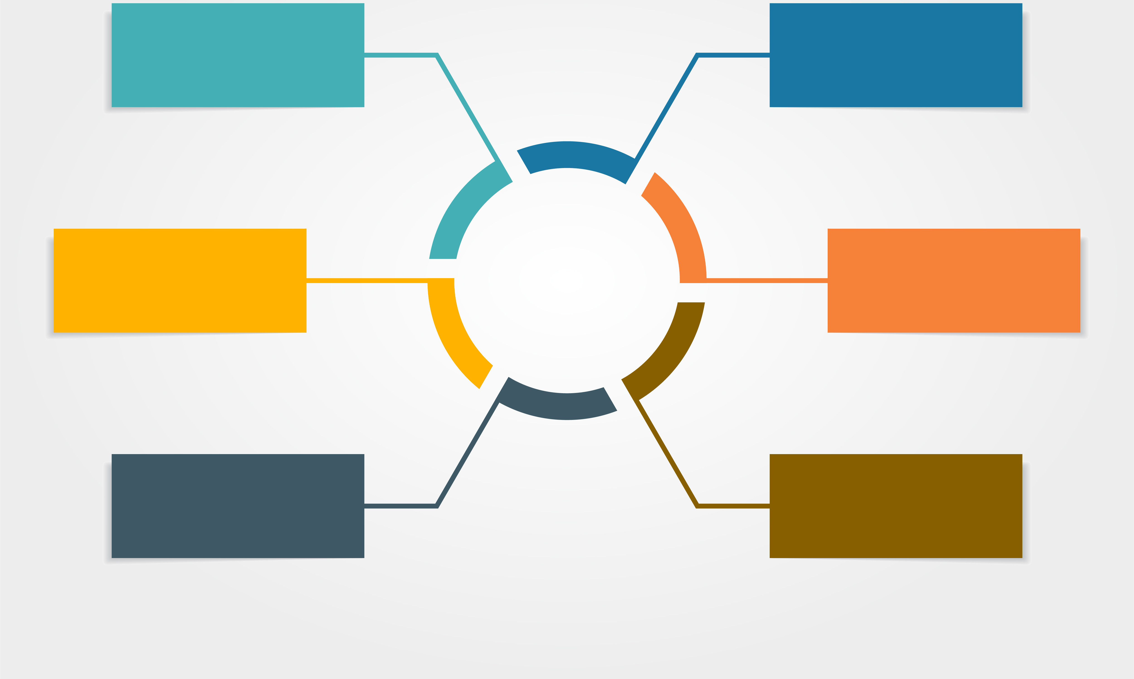
Population PK: the Most Important Components of Model-Informed Drug Development (MIDD)
Population PK
Drug Development
Dose selection and optimization in early Phases of studies.
Identify covariates that might be clinically significant
Derive exposure-metrics for exposure-response analysis
Alternative dosing schemes in clinical studies
Dosing selection in pediatric patients
Inform Drug Use
Characterization of drug pharmacokinetics in specific populations in the label
Drug-Drug Interactions
PK
POPPK
PBPK
PK/PD
Exposure-Response
Disease Models
Clinical Trial Models
MIDD
In Silico
Clinical Trial Simulations
Systems Biology
QSP
QSAR
QSPKR

Slide 23
Submitting Clinical Data for Drug Evaluation
When most people think about study materials submitted with a regulatory submission, the focus is on:
These materials cover a large majority of materials submitted to and, in turn, reviewed by many disciplines.
Concurrent with these materials, modeling and simulation data and results are submitted for review.
Datasets in CDISC format are received and evaluated in almost all clinical studies received by the Agency
1
2
3
Clinical and Nonclinical Study Reports
Clinical and Nonclinical Datasets
Additional Supporting Documentation and Materials

Slide 24
Population PK Datasets are Crucial Components in NDA/BLA and Supplement Submissions
More than 85% of NDA/BLA Submissions Include Population PK analysis report
Most commonly, materials are placed in:
5.3.3.5 Population PK Study reports and related information
Less commonly:
5.3.1.2 Comparative BA and bioequivalence (BE) Study reports and related information
5.3.1.3 In Vitro - in Vivo correlation Study reports and related information
5.3.2.2 Reports of hepatic metabolism and drug interaction studies
5.3.4.2 Patient PD and PK/PD Study reports and related information
5.3.5.3 Reports of analyses of data from more than one study
5.3.5.4 Other Study reports and related information
Then occasionally in:
All other 5.3.3, 5.3.4, and 5.3.5 Modules
All other 5.3.5 Modules
M4 and M5, though this is usually for PBPK analysis
However, population PK datasets are not submitted in CDISC format.
The Comprehensive Table of Contents Headings and Hierarchies: https://www.fda.gov/media/76444/download

Slide 25
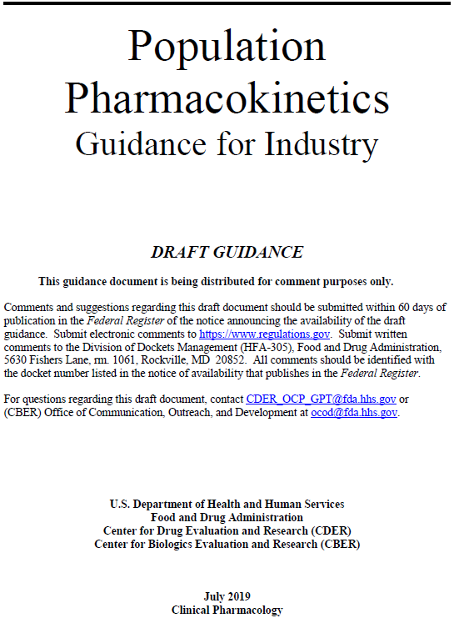
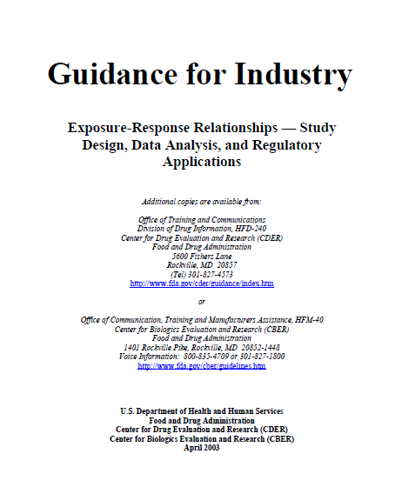
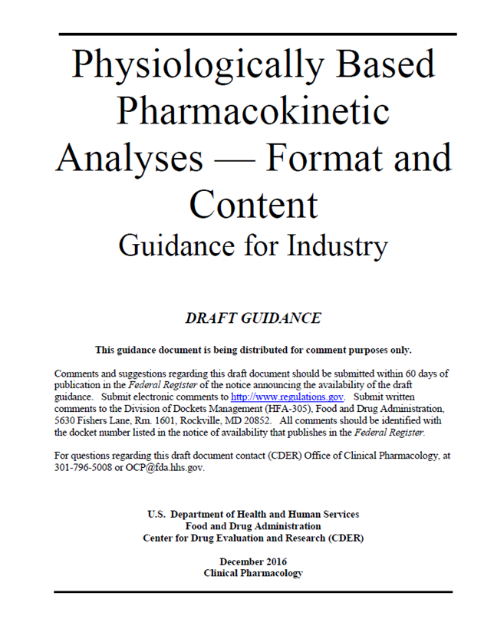
Population PK and Related Guidances
Population PK
Exposure-response
PBPK*
FDA Guidance Webpage: https://www.fda.gov/regulatory-information/search-fda-guidance-documents
*Also PBPK guidance published by OPQ: The Use of PBPK Analyses — Biopharmaceutics Applications for Oral Drug Product Development, Manufacturing Changes, and Controls
Notes:
Issued in 1999 (under revision)
Original guidance focused on methodology
Planned updates will encourage ‘Issue driven’ use of population pharmacokinetics M&S to inform drug use
Emphasis on collecting high quality data
Emphasis on ‘fit for purpose’ model evaluation
Recommendations on reporting of population PK results
Issued in 2003 (under revision)
Importance of integrating E-R relationship assessment in all phases of drug development
Points to consider while designing an E-R study
Format and content of reports of E-R studies
Issued on Dec 2, 2016
To facilitate efficient, timely and consistent FDA review of applications using PBPK
Does not address methodological considerations and best practices for the conduct of PBPK modeling and simulation, or the appropriateness of PBPK analyses for a particular drug or a drug product
Two months public commenting period

Slide 26
How Modeling and Simulation Results Are Prepared, Submitted, and Reassembled
Analysts at Pharmaceutical
Analysts at FDA
Perform analyses to be submitted with an application
Construct a project workflow with model datasets and scripts appropriate for software and approaches used
Write a study report of results
Copy and rename files to align with ‘expectations’ for a submission
Provide instructions for assembly
Provide materials to regulatory for submission
Receive materials as part of a submission
May have to look in multiple locations to find the materials
Follow the instructions provided by a sponsor
Identify what datasets are need to recreate and review and analysis
Rename files, and at times, create a directory structure
Identify problems that arise or send information requests to sponsors
Multiple steps requiring renaming, disassembling, and reassembling

Slide 27
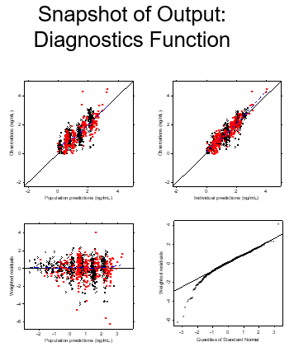
How Population PK Modeling and Simulation Studies Are Evaluated
Population PK analysis are checked via standard operating procedures (SOP) for: data integrity, repeatability, and validation.
Externally and internally developed tools are used to facilitate the process
Analyses (data quality, validation)
Independent Analysis
Decision and Action
PC
DM
PopPK
Dataset
And Codes
Translate
M&S output into action
LB
EX

Slide 28
Challenges in Conducting Population PK Analysis: Lack of Standards in Datasets and Tools
Pre CLINICAL
First-in human
PK & PD
Preliminary
safety and efficacy
PK & PD data relating biomarkers and endpoints to safety and efficacy
More robust safety and efficacy with sparse PK in broader target population
In vitro PD
Animal PK & PD
Data
Generated
Quantitative systems pharmacology, drug-disease-trials models, pharmacokinetic-pharmacodynamic modeling, dose-response/exposure-response analysis, population pharmacokinetic modeling, physiologically-based pharmacokinetic modeling, in-vivo/in-vitro correlation
Analysis Tools
Target Selection
Feasibility
Go-No Go
Regimen selection
Go / No-Go Decisions
Phase 3 Dose Selection
Intrinsic/Extrinsic factors
Data driven dose modifications for safety and efficacy
Challenges

Slide 29
Strategy: Create CDISC-Compliant Data Structure from Single or Multiple Studies for PopPK Analysis and Disease Models
Advantages
Analysis-ready: The ADPPK dataset may be used to create tables, listings, and figures. These outputs may include observed concentration-time data, summary of demographics and covariates included in the analysis for reporting and diagnostic purposes.
Software-independent: While heavily influenced by NONMEM, no endorsement of any specific software or programming
Source dataset traceable: SDTM source dataset (EX, EC, ADSL) should be identifiable.
PC
DM
ADPPK
……..
ADSL
ADLB
ADEFF
ADAE
AE
LB
CDISC&
Non-CDISC
EX
VS
EP
CM

Slide 30
What’s Next for the Agency?
Internal discussion on reviewing and utilization of ADPPK datasets
Update its model/data format website regarding preparation and submission of ADaM ADPPK for NDA/BLA
A future discussion regarding reporting of standard population PK parameters (Similar to ADPP based on NCA)

Slide 31
Take Home Messages
A CDISC format data standard (ADPPK) for population PK analysis has been released in October 2023 by CDISC committee as ADaM format for potential submission in the future.
The implementation of the standard data structure for population PK analysis is expected to improve data quality, facilitate tool development, accelerate collaboration across the pharmacometrics community, and enhance communication with the Agency.
We encourage early discussion on plans for submission with the Agency if there are any questions.

Slide 32
Acknowledgements
Many staff members, reviewers, and leadership from
Office of Clinical Pharmacology
Former and current colleagues and leaders: Dr. Jee Eun Lee, Dr. Jeffry Florian, Dr. Yaning Wang, Dr. Jiang Liu, and Dr. Hao Zhu
Office of Strategic Programming
Office of Business Informatics

Slide 33
Q&A
Q: Can the ADPPK Dataset be directly used in NONMEM?
A: Yes, ADPPK has both numeric and character variables. Since NONMEM doesn’t accept char variables they can be
pushed to all the way right side after the last numeric variable in the dataset. NONMEM ignores char variables after
the last numeric variable automatically.
Q: Will FDA require ADPPK standard?
A: FDA strongly recommends sponsors to submit the ADPPK dataset but it is not mandatory at this time.
FDA will update their guidance to recommend the ADPPK standard. FDA is accumulating experience in using this
new standard, and doesn’t have a definite timeline at this moment.
Q: Can you give more info on required vs optional vars
A: The ADPPK IG has the full list of required variables. All permissible variables can be made optional as per the
requirements of the analysis, any additional variables not in the ADPPK list can be added following the
ADaM naming conventions.
Q: Do we need a special data spec/define submitted with ADPPK?
A: Define.xml or define.pdf can be used to submit ADPPK data definition file. Submitting a complete specification as
an appendix to Pharmacometrics report can be useful for documentation.

